Slide 1
POLLUTION
DIFFERENT KINDS OF POLLUTION:-

Slide 2
WHAT CAUSES OF POLLUTION? When it comes to pollution, there isn’t just one cause. There are lots of them. However, before we can break down what causes pollution and the types of pollution, it’s important to look at what pollution is. In simple terms, pollution is the introduction of harmful chemicals into some areas of the environment. This could be the toxic gases released from the burning of fossil fuels, or it could be the ash created by a natural volcano eruption. As you can see, pollution can have natural causes or be caused by humans. Let’s explore the different types of pollution and what causes them.

Slide 3

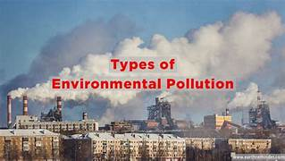
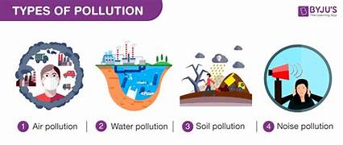
7 DIFFERENT KINDS OF POLUTION
AIR POLLUTION
LAND POLLUTION
NOISE POLLUTION
THERMAL POLLUTION
LIGHT POLLUTION
WATER POLLUTION
RADIOACTIVE POLLUTION

Slide 4
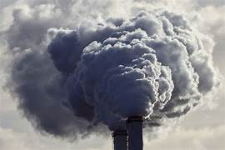
AIR POLLUTION:-
In some cities, the air is dangerous to breathe. Why? Well, air pollution of course. Air pollution is when noxious gases and chemicals get suspended in air. Think about the smog covering some areas of California and New York. Dirt, grime, exhaust fumes, and other aerosols go into the air. These pollutants can go up in the atmosphere and infect our clouds creating acid rain, or they can just hang out like smog does and make it harder for people to breathe.

Slide 5
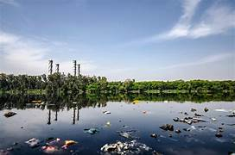
WATER POLLUTION
Humans need water to survive. That is a fact. However, trash and chemicals can get thrown into the ocean and lakes. This is called water pollution. Not only can they affect fish and other marine life, when pollutants get into the water, they have a devastating effect on the water cycle. Natural causes of water pollution include algae blooms and volcanos. However, humans also cause water pollution through trash and wastewater from factories.

Slide 6
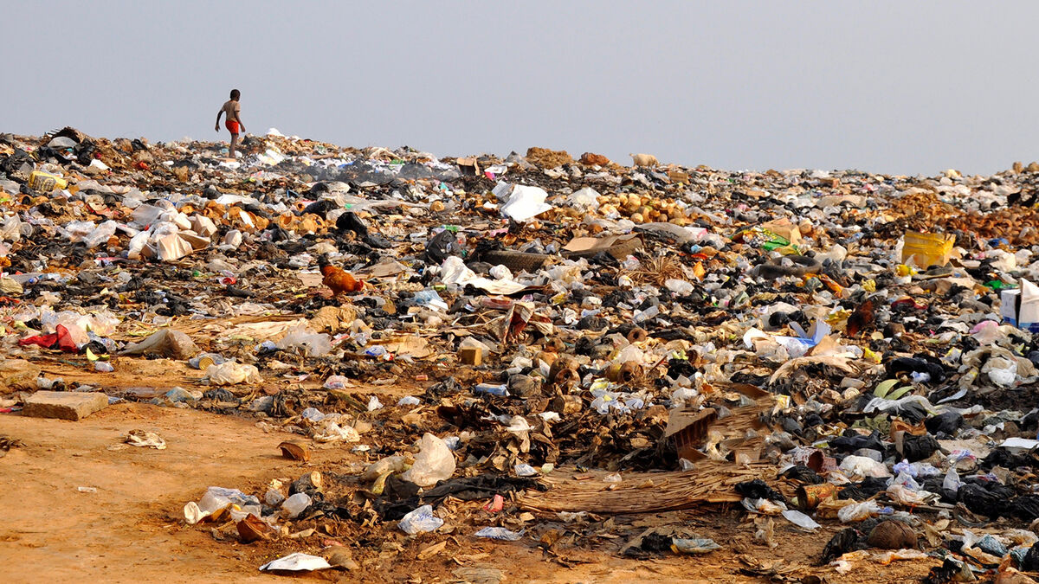
LAND POLLUTION
LAND POLLUTION is another one of the big three pollution types affecting the human population. Land pollution happens when the soil gets contaminated by fertilizers or chemicals being dumped. The pollution in the land can seep into the ground water or run into lakes and streams creating a vicious pollution cycle.

Slide 7
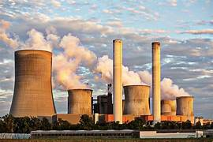
RADIOACTIVE POLLUTION
When you think of radioactive pollution, you might think of Chernobyl or Fukushima. Both of these nuclear power plants used fission of radioactive materials, uranium and plutonium, to create electricity, and both failed. Their failure led to toxic chemicals and radiation being leaked out into the environment, which is radioactive pollution.

Slide 8
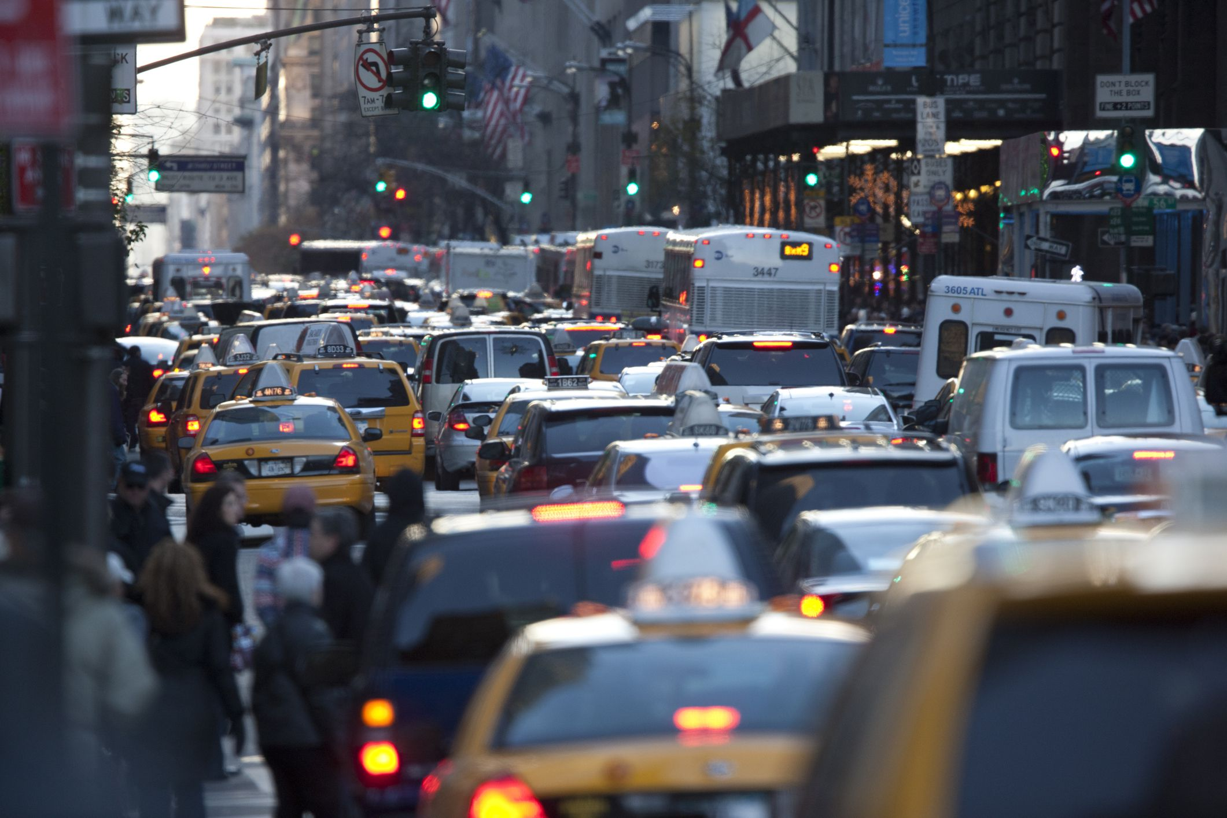
NOISE POLLUTION
Noise pollution is caused by loud noises that can hurt the human ears. Types of noise pollution can include explosions, jet engines, and even concerts (if you are close to the speakers). Noise pollution is dangerous because it can cause hearing loss.

Slide 9
LIGHT & THERMAL POLLUTION
LIGHT POLLUTION
THERMAL POLLUTION
Light pollution, using electric lights to light up the sky, is the cause. While lights are great for helping us to see at night, too many lights cause light pollution blocking out the night sky. Light pollution can also be harmful to animals. For example, the lights of big cities can confuse migrateng birds.
While most pollution types are straightforward, thermal pollution is a bit tricky. Many times, nuclear power plants and factories use water to cool things. However, if they put that warmed up water back into the environment, it wreaks havoc on the fish and wildlife because it has less oxygen. This is called thermal pollution. Thermal pollution can be caused by natural forces too like soil erosion giving water more sunlight.

